Slide 1
MyWellnessBuddy
A food logging and wellness app approached by the mind of a dietician
Team 34 – The Fit Fellas
Ogo Alege, Stephen Kelly, Yusup Guldadov, Devam Patel, Zachary Szakacs, Brian Zhou
(egv062) (bjl294) (hze083) (dns682) (bxq315) (baz896)
Notes:
Speaker: Stephen

Slide 2
Presentation Agenda
1.
Product Vision - Stephen
2.
Architecture - Someone
3.
Personas / Roles - all
4.
Epics & User Stories - all
5.
QA Plan - all
6.
Next Steps - Zach
Notes:
Speaker: Stephen

Slide 3
1.
Product Vision
Notes:
Speaker: Stephen

Slide 4
Our Goal
A food logging and wellness app approached by the mind of a dietician
Nutrition > Fitness
Notes:
Speaker: Stephen
- Our goal was to create a food logging and wellness mobile app that was approached by the mind of a dietician
- Current food logging solutions on the market are fitness oriented and trend towards the ultimate goal of becoming lean, or shredded, or generally “fit”
- We wanted to provide a solution to those who are looking for only the nutritional aspect of the app without an idealized physical condition being pushed on them

Slide 5
Stakeholder
Stakeholder: Soon-to-be dietician on their practicum
Concurs with our proposition for the need of this app
Notes:
Speaker: Stephen
- Our stakeholder is a soon-to-be dietician on their practicum
- They agree that for the average daily user, the current popular food logging solutions focus too heavily on fitness and physique

Slide 6
Our Solution
“How would a dietician want someone to think and feel while using the app?”
“What information would a dietician deem suitable for a user to know?”
“What information would a dietician deem not suitable for a user to know?”
“What does the average person wants/needs to know about their food”
Notes:
Speaker: Stephen
- Our solution takes this and asks:
“How would a dietician want someone to think and feel while using the app?”
“What information would a dietician deem necessary/suitable for a user to know?”
“What information would a dietician deem not necessary/suitable for a user to know?”
And how do we balance these with:
“What does the average person wants/needs to know about their food?”
- These are all questions that we considered when approaching the design of our app

Slide 7
2.
Architecture
Notes:
Speaker: ???

Slide 8
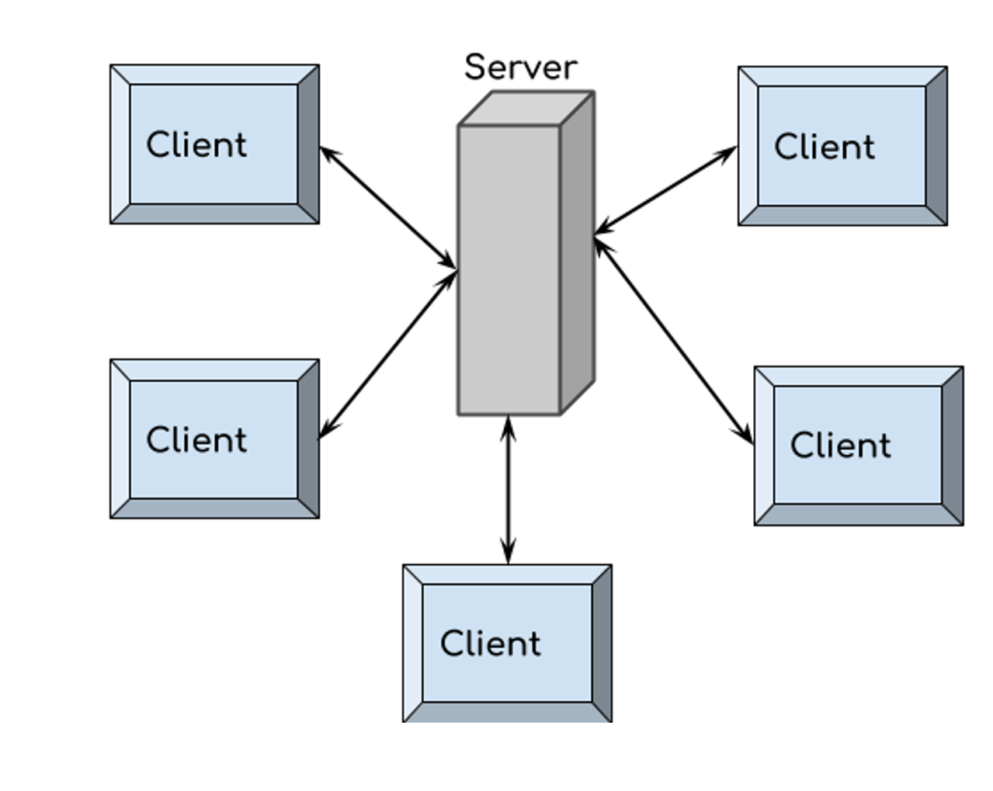
Software Architecture
Client-Server Pattern
One server for many clients
Notes:
Speaker: ???
Front End:
We used:
- React Native as the framework for our app
- Expo Go for running and testing our app

Slide 9


Front End
React Native (framework)
Expo Go (running & testing)
Notes:
Speaker: ???
Front End:
We used:
- React Native as the framework for our app
- Expo Go for running and testing our app

Slide 10


Back End
JavaScript
MongoDB (cloud storage)
Notes:
Speaker: ???
Back End:
- JavaScript
- MongoDB (cloud storage)

Slide 11
3.
Personas / Roles
Notes:
Speaker: ???

Slide 12
Ahmad
Computer Science Student
Vital Statistics:
- 20 years old
- Computer Science Student at the U of S
- Single
- Full time student
Goals/Needs:
- Track nutrition
- Gain weight
Motivations:
- Going to gym
- Eating healthy food
Frustrations:
- No progress since going to gym, even though he has a good plan.
Activities:
- Going to the gym 3 times a week & walking and running outside
- Time mostly spent doing homework
Technical Usage/Proficiency:
- Proficient in his technical usage (computers and phones)
Notes:
Speaker: ???
Name: Ahmad
Vital Statistics:
Age - 20
Job - Computer Science Student at the U of S
Family Situation - Single
Activity Level - Full time student busy schedule
Goals/needs:
Track his nutrition
Trying to gain weight without any use of proteins.
Motivations:
Constantly going to gym
Trying to consume healthy food and gain weight.
Frustrations:
No progress since going to gym, even though has good plan.
Activities:
He is 3 times a week going to gym.
Walking and running outside on his free times.
Most of the time studying.
Technical Usage/Proficiency:
Ahmad is proficient at technical usage (computers and phones), as he is studying computer science program.

Slide 13
William
Student + Part Time Worker
Vital Statistics:
- 22 years old
- University Student at the U of S
- Lives away from family
- Non-active life style
Goals/Needs:
- Timely and cost-effective way to get a health/meal plan
Motivations:
- Wants to stay healthy
- Being time efficient
Frustrations:
- Busy schedule due to school & work (honors program + part-time job)
Activities:
- Goes to gym irregularly due to lack of free time
Technical Usage/Proficiency:
- 5 years experience with phones, tablets, laptops, etc.
Notes:
Speaker: ???
Name: William
Vital Statistics:
Age - 23
Job - University student at the U of S
Family Situation - He lives alone, far away from his family
Activity Level - Very little
Goals/Needs:
He wants an app that can utilize his limited time and budget to customize a health plan (including meal plan) that best fit for him.
Motivations:
He wants to keep healthy, but he does not have much time to do the research and design a health plan for himself. So, he is expecting an app can do that for him.
Frustrations:
He apply honor program and is taking full load of courses for each term.
He and his family doesn’t have much saving so he not only apply for student loan but also takes a part-time job. Thus, he has a very busy schedule.
Activities:
He does some exercise (not regular) when he has free time
Technical Usage/Proficiency:
Has 5 years of experience in using electronic devices including phones, tablets, and laptops

Slide 14
Jeremy
Elementary School Janitor
Vital Statistics:
- 45 years old
- Janitor at an Elementary School
- Married, owns a dog
- Moderately active
Goals/Needs:
- Save money for Bahamas
- Match his wife’s physical activity
Motivations:
- Takes pride in his job
- Loves his dog, often spoils with treats and walks
Frustrations:
- People underestimating his physical ability
Activities:
- Walks dog every morning + night
- Cooks dinner for his wife every night
Technical Usage/Proficiency:
- Decent technical proficiency
- Owns an iPhone for games, books, etc.
Notes:
Speaker: ???
Name: Jeremy
Vital Statistics:
Age - 45
Job - Elementary School Janitor
Family Situation - A wife, no kids, and a dog
Activity Level - Moderate (always moving due to janitor activities)
Goals/needs:
Jeremy wants to save up money for taking his wife on a trip to the Bahamas
Jeremy has a goal of staying active to stay healthy so that he can keep up with his physically active wife
Motivations:
Jeremy takes pride in his job and the physical activity it provides him
Jeremy loves his dog and tends to spoil them with things such as many walks in a day and treats
Frustrations:
Jeremy gets frustrated when people underestimate his physical ability
Activities:
Jeremy walks his dog everyday in the morning and at night, while also staying on the move during his job
Jeremy gets off work earlier than his wife and likes to cook a nice meal for her to get home to
Technical Usage/Proficiency:
Decent technical proficiency. Jerry owns an iPhone and uses it to listen to music, watch videos, and play mobile games. He is familiar with the user interface and likes to download apps for fun.

Slide 15
James
NFL Football Player
Vital Statistics:
- 25 years old
- Professional football player in the NFL
- Away from home, single living
- Constant training + conditioning
Goals/Needs:
- Track food intake
- Optimize nutrients
Motivations:
- Stay in shape
- Performing well on the field
Frustrations:
- Busy schedule with training
- Apps that overwhelm with information
Activities:
- Physical training
- Yoga
- Video games
Technical Usage/Proficiency:
- Very technically proficient
Notes:
Speaker: ???
Name: James Coral
Vital Statistics:
Age/Gender - 25 year old male
Job - Professional football player in the NFL
Family Situation - Moved away from home when he attended college at the University of Michigan. He is an only child that lives on his own in an apartment in Houston, Texas
Activity Level - James spends everyday training to become the best football player he can be. He spends one hour every morning working on his cardio, going for jogs around the local area of his apartment. He attends football practice/training every day for two hours and often spends about an hour after practice to get work done on sore or fatigued muscles.
Goals/needs:
James wants to be able to track his caloric intake to ensure that he is maximizing his muscle gain during his workouts. Since James plays a very physically demanding sport, he wants to ensure that he is as healthy as he can be. He understands that nutrition is very important to remaining both physically and mentally healthy, so he wants to be able to easily log and track his food. On top of logging his food, James wants to know if he is eating enough of the essential food groups each day. He wants the app to be very easy to use and shows clear instructions on everything the app has to offer (he does not want to waste time trying to enter food into his food log).
Motivations:
James' job requires him to be in the best shape possible for him to succeed and stay healthy in the NFL. He understands that nutrition is very important to his success and wants to be able to closely monitor what he is eating so he can maximize his performance level on and off the field.
Frustrations:
James has a very busy schedule and often finds that he does not have time to keep track of the food is eating throughout the day. The apps he has tried using in the past overwhelmed him and he gave up on them very quickly.
Activities:
James is a very high-level athlete that spends lots of time throughout each and everyday training to become the best version of himself. In his off time, James enjoys yoga and playing video games on his PlayStation.
Technical Usage/Proficiency:
James grew up in a wealthy family where he constantly had access to modern technology such as a laptop and the newest smart phone. He has played video games ever since he was a child and continues to do so in his spare time. James has a ton of experience with iPads, as he watches football film to study for his next game. He makes notes while he's watching on his iPad and constantly is drawing all over the screen on different movements and pointers that the teams are showing in film.

Slide 16
Bob
Accountant
Vital Statistics:
- 50 years old
- Accountant
- Wife, 2 kids
- Light morning jogs
Goals/Needs:
- To lose weight
- Eat healthier doods
Motivations:
- Prediabetic diagnosis
- Wants to avoid potential diabetes
Frustrations:
- Gym membership and junk food restriction led nowhere for weight loss
Activities:
- Jogs with his wife and oldest daughter 3 times a week
Technical Usage/Proficiency:
- Above average technical proficiency due to working on computer at job
Notes:
Speaker: ???
Name: Bob Maddox
Vital Statistics:
Age - 50 years old
Job - Accountant
Family Situation - A wife and 2 kids
Activity Level - Morning jogs
Goals/needs:
To lose weight and eat healthier by including more vegetables in his diet.
Motivations:
The doctor recently informed him that he is prediabetic and getting dangerously close to developing type 2 diabetes.
Frustrations:
Bob Purchased a gym membership 6 months ago and made a pledge to quit eating fast food but no progress has been made in terms of weight loss.
Activities:
Morning jogs three times a week with his wife and oldest daughter
Technical Usage/Proficiency:
Slightly above average proficiency with the use of technology due to his requirement to understand different technologies to do his job.

Slide 17
Aakash
Software Dev Intern
Vital Statistics:
- 21 years old
- Software developer intern of 4 months
- Lives alone, sees friends
Goals/Needs:
- Cut out junk food
- Start meal prepping
Motivations:
- Prioritizing health with his extra time and money
Frustrations:
- Lacking ingredients for YouTube recipe tutorials
Activities:
- Cooking at night after work
- Spending time with friends otherwise
Technical Usage/Proficiency:
- Very technically proficient
Notes:
Speaker: ???
Name: Aakash
Vital Statistics:
Age - 21
Job - software developer intern at abc for 4 months.
Family Situation - he is single, lives alone in a 1-bedroom apartment usually meets his friends from the university on weekends
Goals/needs:
He wants to stop eating takeaway foods and start preparing more meals at home which he didn't use to do very often in his student life and eat more healthy food because he is concerned that if he doesn't focus on his health now, he will soon get fat because his job now does not involve a lot of movement throughout the day in weekdays and on weekends he usually prefers staying at home and rest.
Motivations:
In his student life he used to be very busy with his school, part time job, doing assignments and doesn’t have a lot of time or money to focus on eating healthy food, so he used to eat things that wouldn't take much time to cook, healthy or not. But now that he is earning good and has spare time to cook almost everyday, he wants to focus on his health more and learn new recipes.
Frustrations:
He used to watch videos on YouTube to learn new recipes, but often found out that he doesn't have all the required ingredients at home, and he forgets to buy them when he goes to buy groceries for the week. So, he wants an app that would give him recipes for healthy meals from the ingredients he has, remind him of items he needs to buy on Monday, when he goes to the store to buy groceries for the week and give him an estimate time it would take for preparing the meal.
Activities:
On weekdays he goes to work in the morning, comes back home in the evening at around 6pm, sometimes goes to buy groceries, eats something then watches a Netflix show or plays video games with his friends and goes to sleep. On weekends he does his laundry, plays games with his friends, meets his friends and sometimes goes out for a dinner with them.
Technical Usage/Proficiency:
He is very proficient and doesn't like it when an app he uses keeps changing its interface in every updates.

Slide 18
4.
Epics & User Stories
Notes:
Speaker: ???

Slide 19
Necessary Design Questions
“How would this app be able to benefit a user?”
“Where would people be using our app?”
“What kind of information/services are people in need of?”
“Why would people use our app and not others?”
Many more …
Notes:
Speaker: ???
Some questions that we needed to ask ourselves when coming up with ideas for epics and user stories were:
“How would this app be able to benefit a user?”
“Where would people be using our app?”
“What kind of information/services are people in need of?”
“Why would people use our app and not others?”
And many other questions

Slide 20
Epic 1
As full-time student, Ahmad wants to schedule his healthy meal plan for a week so that he can stick to a routine to gain weight
Notes:
Speaker: ???
Epic 1:
- As full-time student, Ahmad wants to schedule his healthy meal plan for a week so that he can stick to a routine to gain weight
User Stories we kept:
User Story 1:
- As Ahmad I want to have healthy proper meal plan with sufficient calories to gain weight (Meal Plan Generation)
- 6 points
User Story 2:
- As Ahmad I want to track my gain weight process while following recommended meal plan (Weight Tracking)
- 1 point
User Story 3:
- As Ahmad I want to schedule my meal plan, next day meal times, my study time and my free times (Schedule Event & Meals)
- 2 points
User Story 4:
- As Ahmad I want to know what my recommended calorie and nutrient intake should be based on my goal weight so that I can properly work towards achieving my weight goal (User Goals Based on Weight)
- 2 points
User Stories we didn’t keep:
None

Slide 21
Epic 1
User Stories:
1 – As Ahmad I want to have healthy proper meal plan with sufficient calories to gain weight (Meal Plan Generation)
2 – As Ahmad I want to track my gain weight process while following recommended meal plan (Weight Tracking)
Notes:
Speaker: ???
Epic 1:
- As full-time student, Ahmad wants to schedule his healthy meal plan for a week so that he can stick to a routine to gain weight
User Stories we kept:
User Story 1:
- As Ahmad I want to have healthy proper meal plan with sufficient calories to gain weight (Meal Plan Generation)
- 6 points
User Story 2:
- As Ahmad I want to track my gain weight process while following recommended meal plan (Weight Tracking)
- 1 point
User Story 3:
- As Ahmad I want to schedule my meal plan, next day meal times, my study time and my free times (Schedule Event & Meals)
- 2 points
User Story 4:
- As Ahmad I want to know what my recommended calorie and nutrient intake should be based on my goal weight so that I can properly work towards achieving my weight goal (User Goals Based on Weight)
- 2 points
User Stories we didn’t keep:
None

Slide 22
Epic 1
User Stories:
3 – As Ahmad I want to schedule my meal plan, next day mealtimes, my study time and my free times (Schedule Event & Meals)
4 – As Ahmad I want to know what my recommended calorie and nutrient intake should be based on my goal weight so that I can properly work towards achieving my weight goal
(User Goals Based on Weight)
Notes:
Speaker: ???
Epic 1:
- As full-time student, Ahmad wants to schedule his healthy meal plan for a week so that he can stick to a routine to gain weight
User Stories we kept:
User Story 1:
- As Ahmad I want to have healthy proper meal plan with sufficient calories to gain weight (Meal Plan Generation)
- 6 points
User Story 2:
- As Ahmad I want to track my gain weight process while following recommended meal plan (Weight Tracking)
- 1 point
User Story 3:
- As Ahmad I want to schedule my meal plan, next day meal times, my study time and my free times (Schedule Event & Meals)
- 2 points
User Story 4:
- As Ahmad I want to know what my recommended calorie and nutrient intake should be based on my goal weight so that I can properly work towards achieving my weight goal (User Goals Based on Weight)
- 2 points
User Stories we didn’t keep:
None

Slide 23
Epic 2
As William I want to be able to customize and manage a health plan for myself so that I can keep healthy
Notes:
Speaker: ???
Epic 2:
- As William I want to be able to customize and manage a health plan for myself so that I can keep healthy
User Stories we kept:
User Story 1:
- As William I want to be able to design meal plan so that I can eat healthy (Design a Meal Plan)
- 2 points
User Stories we didn’t keep:
User Story 2:
- As William I want to be able to notify myself when to do what so that I can follow my plan.
User Story 3:
- As William I want to be able have everything plan out and listed into a calendar so that I could double check and edit my plan.

Slide 24
Epic 2
User Stories:
1 – As William I want to be able to design meal plan so that I can eat healthy (Design a Meal Plan)
Notes:
Speaker: ???
Epic 2:
- As William I want to be able to customize and manage a health plan for myself so that I can keep healthy
User Stories we kept:
User Story 1:
- As William I want to be able to design meal plan so that I can eat healthy (Design a Meal Plan)
- 2 points
User Stories we didn’t keep:
User Story 2:
- As William I want to be able to notify myself when to do what so that I can follow my plan.
User Story 3:
- As William I want to be able have everything plan out and listed into a calendar so that I could double check and edit my plan.

Slide 25
Epic 3
Jeremy is curious to see how many calories he eats in a day and keep track of the nutritional aspects of his wife's and his own favourite recipes
Notes:
Speaker: ???
Epic 3:
- Jeremy is curious to see how many calories he eats in a day and keep track of the nutritional aspects of his wife's and his own favourite recipes
User Stories we kept:
User Story 1:
- As Jeremy I want to keep track of recipes so that I can view the nutritional aspects of them (Track Recipes)
- 1 point
User Story 3:
- As Jeremy I want to add custom recipes to my food log so that I can keep a realistic image of my calorie intake (Create Custom Recipes)
- 2 points
User Stories we didn’t keep:
User Story 2:
- As Jeremy I want to view the amount of calories I've eaten in a day so that I can satiate my curiosity and see if I am in a calorie deficit.

Slide 26
Epic 3
User Stories:
1 – As Jeremy I want to keep track of recipes so that I can view the nutritional aspects of them (Track Recipes)
3 – As Jeremy I want to add custom recipes to my food log so that I can keep a realistic image of my calorie intake
(Create Custom Recipes)
Notes:
Speaker: ???
Epic 3:
- Jeremy is curious to see how many calories he eats in a day and keep track of the nutritional aspects of his wife's and his own favourite recipes
User Stories we kept:
User Story 1:
- As Jeremy I want to keep track of recipes so that I can view the nutritional aspects of them (Track Recipes)
- 1 point
User Story 3:
- As Jeremy I want to add custom recipes to my food log so that I can keep a realistic image of my calorie intake (Create Custom Recipes)
- 2 points
User Stories we didn’t keep:
User Story 2:
- As Jeremy I want to view the amount of calories I've eaten in a day so that I can satiate my curiosity and see if I am in a calorie deficit.

Slide 27
Epic 4
As James Coral, I want to be able to log and track the food and nutrients I consume so that I can maximize my performance on and off the field as a player in the NFL
Notes:
Speaker: ???
Epic 4:
- As James Coral, I want to be able to log and track the food and nutrients I consume so that I can maximize my performance on and off the field as a player in the NFL.
User Stories we kept:
User Story 1:
- As James Coral, I want to be able to keep track of the food I eat each meal so that I can ensure that I am getting the macro and micro-nutrients I need to stay physically in shape for my job (Logging Food)
- 5 point
User Story 2:
- As James Coral, I want to be able to compare my caloric intake and nutrients to my expected caloric intake and nutrients so that I can have a clear way to observe what I need to eat more/less of in my diet (Compare Nutrient Intake to Goal)
- 4 points
User Stories we didn’t keep:
User Story 3:
- As James Coral, I want to be able to save meals that I eat consistently so that I do not have to waste time during my day logging the same foods

Slide 28
Epic 4
User Stories:
1 – As James Coral, I want to be able to keep track of the food I eat each meal so that I can ensure that I am getting the macro and micro-nutrients I need to stay physically in shape for my job (Logging Food)
2 – As James Coral, I want to be able to compare my caloric intake and nutrients to my expected caloric intake and nutrients so that I can have a clear way to observe what I need to eat more/less of in my diet (Compare Nutrient Intake to Goal)
Notes:
Speaker: ???
Epic 4:
- As James Coral, I want to be able to log and track the food and nutrients I consume so that I can maximize my performance on and off the field as a player in the NFL.
User Stories we kept:
User Story 1:
- As James Coral, I want to be able to keep track of the food I eat each meal so that I can ensure that I am getting the macro and micro-nutrients I need to stay physically in shape for my job (Logging Food)
- 5 point
User Story 2:
- As James Coral, I want to be able to compare my caloric intake and nutrients to my expected caloric intake and nutrients so that I can have a clear way to observe what I need to eat more/less of in my diet (Compare Nutrient Intake to Goal)
- 4 points
User Stories we didn’t keep:
User Story 3:
- As James Coral, I want to be able to save meals that I eat consistently so that I do not have to waste time during my day logging the same foods

Slide 29
Epic 5
Bob wants to make meals he can enjoy that do not risk his health (i.e., avoiding diabetes and an allergic reaction to nuts)
Notes:
Speaker: ???
Epic 5:
- Bob wants to make meals he can enjoy that do not risk his health (i.e. avoiding diabetes and an allergic reaction to nuts)
User Stories we kept:
User Story 3:
- As Bob I want to be able to get meal suggestions that do not include nuts of any kind so that I don’t trigger a severe allergic reaction (Forbidden Foods)
- 1 point
User Stories we didn’t keep:
User Story 1:
- I’m Bob and I want to be able to get healthy meal suggestions and keep track of the number of calories I eat in a day so that I can lose weight and improve my health in general
- 1 point
User Story 2:
- As Bob I want to be able to make meals that keep me satiated so that I have energy when I need it like during my morning jogs.

Slide 30
Epic 5
User Stories:
3 – As Bob I want to be able to get meal suggestions that do not include nuts of any kind so that I don’t trigger a severe allergic reaction (Forbidden Foods)
Notes:
Speaker: ???
Epic 5:
- Bob wants to make meals he can enjoy that do not risk his health (i.e. avoiding diabetes and an allergic reaction to nuts)
User Stories we kept:
User Story 3:
- As Bob I want to be able to get meal suggestions that do not include nuts of any kind so that I don’t trigger a severe allergic reaction (Forbidden Foods)
- 1 point
User Stories we didn’t keep:
User Story 1:
- I’m Bob and I want to be able to get healthy meal suggestions and keep track of the number of calories I eat in a day so that I can lose weight and improve my health in general
- 1 point
User Story 2:
- As Bob I want to be able to make meals that keep me satiated so that I have energy when I need it like during my morning jogs.

Slide 31
Epic 6
As a bachelor living alone, I want to be able to see recipes for healthy meals based on some of the ingredients I have at my house so that I can stay prepared for cooking healthy meals next week.
Notes:
Speaker: ???
Epic 6:
- As a bachelor living alone, I want to be able to see recipes for healthy meals based on some of the ingredients I have at my house so that I can stay prepared for cooking healthy meals next week.
User Stories we kept:
User Story 1:
- As a bachelor living alone, I want to be able to see recipes of healthy meals based on some of the ingredients I have at my house so that I can prepare a healthy meal for myself if I have all the major ingredients or plan to buy the missing ingredients when I go to the store to buy groceries (Meals Based on Food You Have)
- 5 point
User Story 2:
- As a bachelor living alone, I want to be able to see the list of items to buy for the week and mark the items I already picked, so that I do not forget anything (Pantry for Tracking Food in Your House)
- 3 points
User Stories we didn’t keep:
User Story 3:
- As a person who works as an intern in a software company, I want to be able to be reminded about my trip to the grocery store so that I do not forget about it if I have a busy week at work

Slide 32
Epic 6
User Stories:
1 – As a bachelor living alone, I want to be able to see recipes of healthy meals based on some of the ingredients I have at my house so that I can prepare a healthy meal for myself
(Meals Based on Food You Have)
2 – As a bachelor living alone, I want to be able to see the list of items to buy for the week and mark the items I already picked, so that I do not forget anything (Pantry for Tracking Food in Your House)
Notes:
Speaker: ???
Epic 6:
- As a bachelor living alone, I want to be able to see recipes for healthy meals based on some of the ingredients I have at my house so that I can stay prepared for cooking healthy meals next week.
User Stories we kept:
User Story 1:
- As a bachelor living alone, I want to be able to see recipes of healthy meals based on some of the ingredients I have at my house so that I can prepare a healthy meal for myself if I have all the major ingredients or plan to buy the missing ingredients when I go to the store to buy groceries (Meals Based on Food You Have)
- 5 point
User Story 2:
- As a bachelor living alone, I want to be able to see the list of items to buy for the week and mark the items I already picked, so that I do not forget anything (Pantry for Tracking Food in Your House)
- 3 points
User Stories we didn’t keep:
User Story 3:
- As a person who works as an intern in a software company, I want to be able to be reminded about my trip to the grocery store so that I do not forget about it if I have a busy week at work

Slide 33
User Stories Completed
E 1 US 1
E 1 US 2
E 1 US 3
E 1 US 4
E 2 US 1
E 3 US 1
E 3 US 3
E 4 US 1
E 4 US 2
E 5 US 3
E 6 US 1
E 6 US 2
Notes:
Speaker: ???

Slide 34
5.
QA Plan
Notes:
Speaker: ???

Slide 35
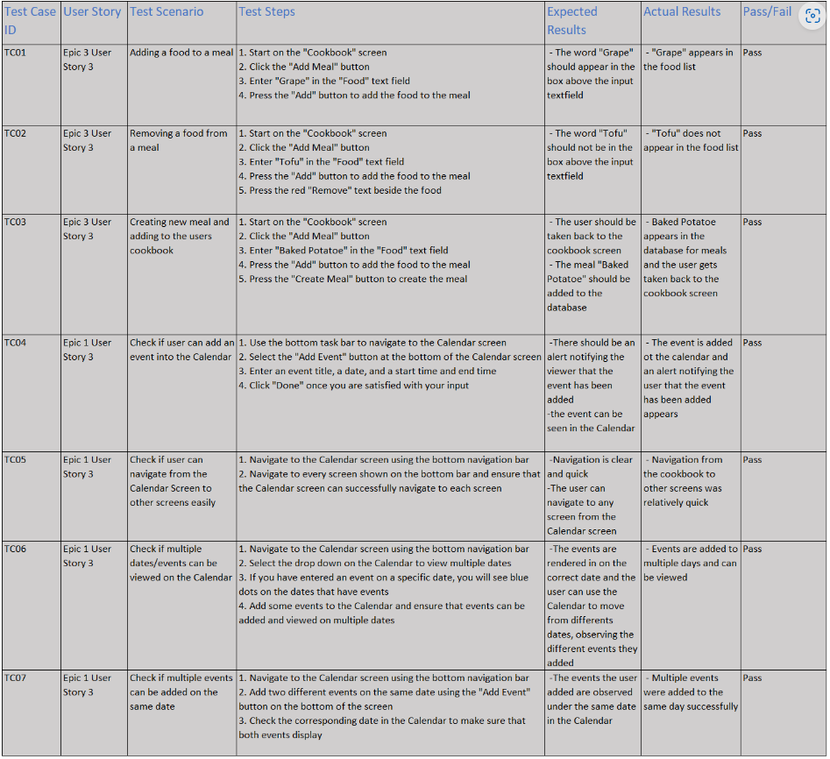
Front End
Integration Testing
Manual task-based walk-throughs
Notes:
Speaker: ???
Front End Testing:
- Integration Testing
- For testing the front end of our app, we manually walked through a series of navigations and inputs that correspond to a series of expected results.
*** reference the table for this next part ***
- We give a list of instructions for the tester to carry out
- We then compared the expected results of those actions to the actual results to decide if the tests were successful.

Slide 36
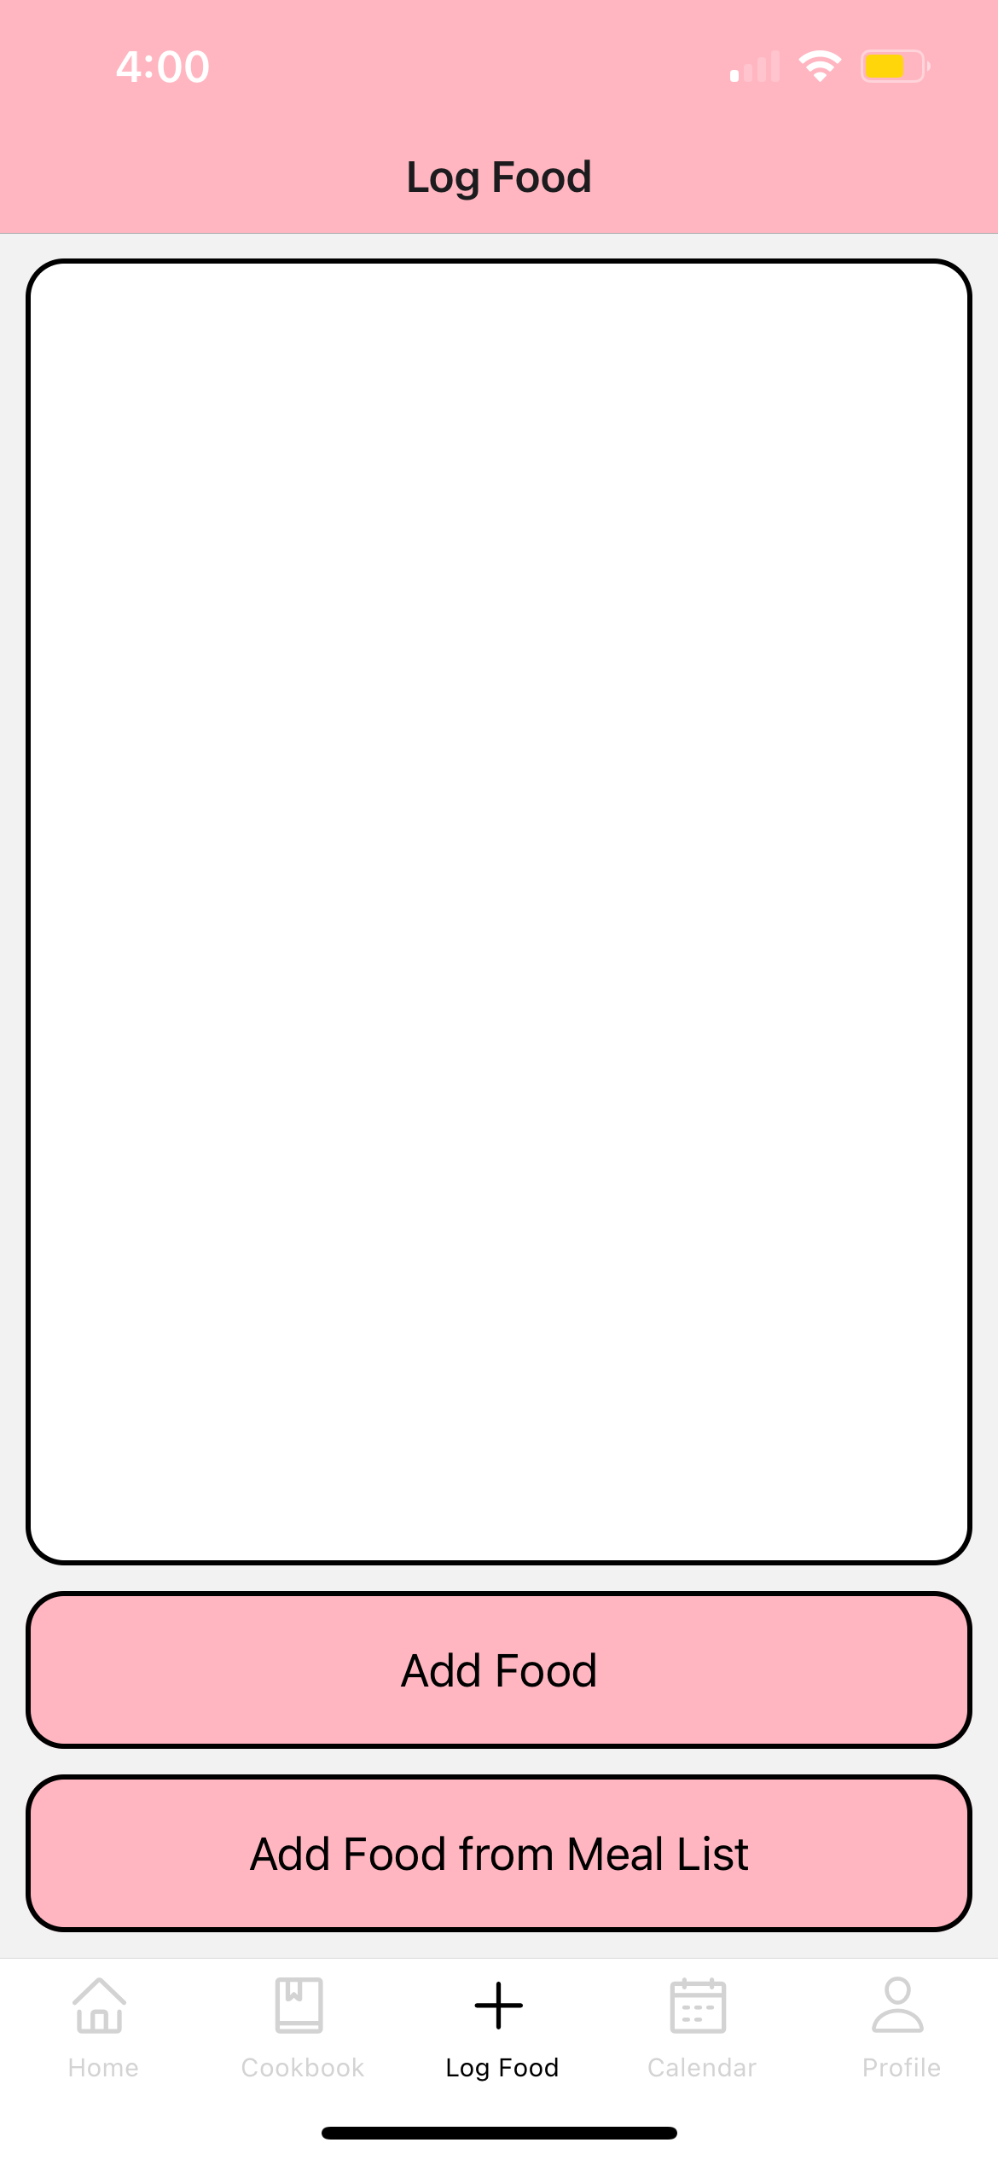
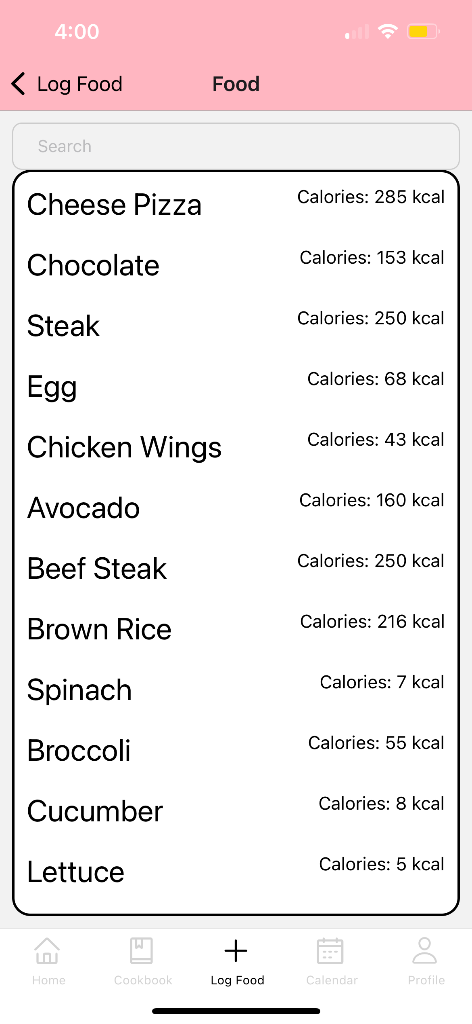
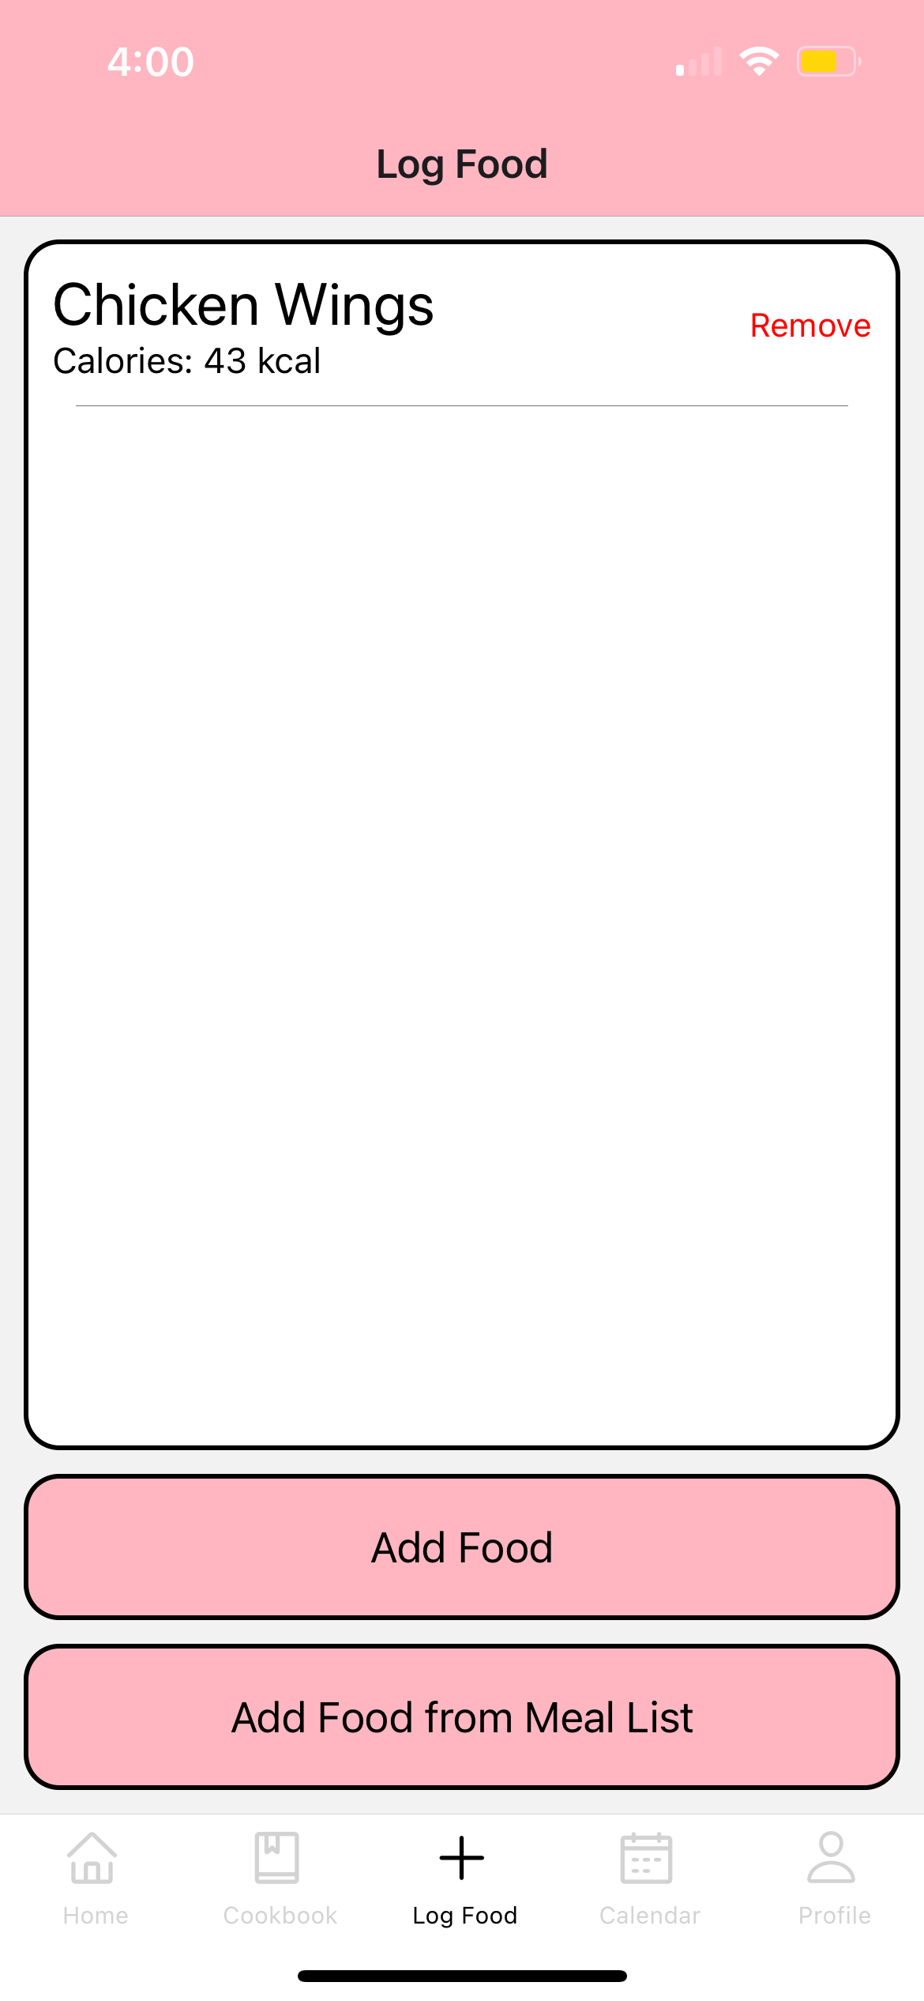
Testing (Walkthrough)
Notes:
Speaker: ???
Front End Testing:
- Integration Testing
- For testing the front end of our app, we manually walked through a series of navigations and inputs that correspond to a series of expected results.
- We then compared the expected results to the actual results to decide if the tests were successful.

Slide 37
Back End
Unit Testing
searchOne() and getAll() from database
Regression Testing
Class specific automated testing
System Testing
Manual API Testing (Postman)
Notes:
Speaker: ???
Back End Testing
- For back end, we used a combination of
1. Unit Testing
2. Regression Testing
3. System Testing

Slide 38

Back End
Unit Testing
searchOne() and getAll() from database
Notes:
Speaker: ???
Unit Testing
Test functions searchOne() and getAll() that gets one/a list of data from database (MongoDB)
Test Pantry.js including all its functions
*** Talk about image ***

Slide 39
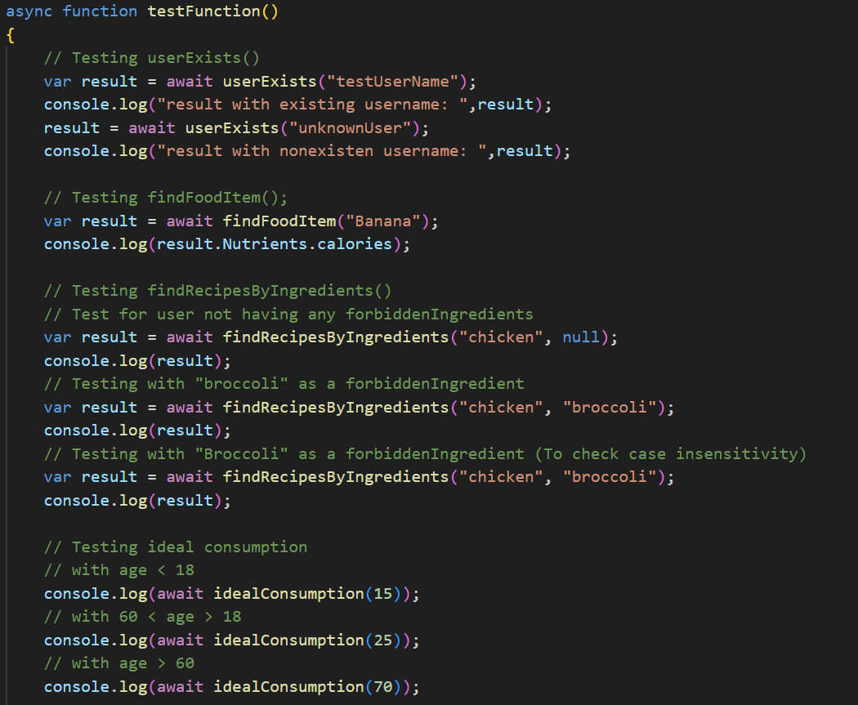
Back End
Regression Testing
Class specific automated testing
Notes:
Speaker: ???
Regression Testing
Test every method in each class using normal and special case inputs.
Test Pantry.js including all its functions
*** Talk about image ***

Slide 40
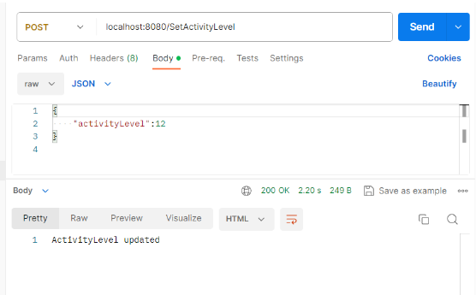
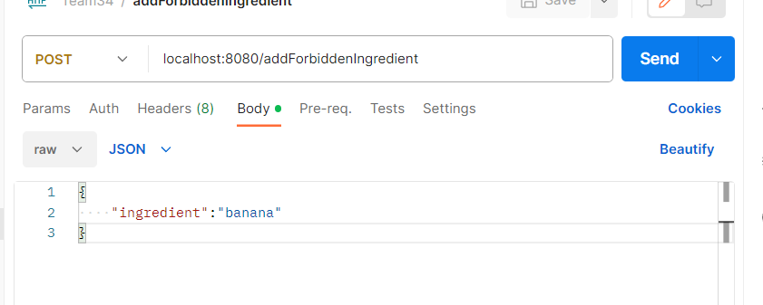
Back End
System Testing
Manual API Testing (Postman)
Notes:
Speaker: ???
Regression Testing
Test API through postman
*** Talk about image ***

Slide 41
6.
Next Steps
Notes:
Speaker: Zach

Slide 42

Next Steps
Clean up/polish existing code and features
Expand database
- Dietician approved
3. User Profiles
- Passwords & Security
4. Integration with existing API’s
5. Go to market
Notes:
Speaker: Zach
Next Steps
- The end goal for any application here would likely be to go to market In order to go to market, the following steps would need to be taken:
Take a step back and reformat/unify our code & polish our current features Some parts are inconsistent due to lack of communication
After cleaning up our code, expand our database of foods and meals
- These new meals would be rated and filtered by dieticians and experts in the field of nutrition
User profiles would be next Users could create their own unique list of meals
- Security would have to be addressed at this time due to the addition of personal accounts
Integration with existing food and meal curation API’s could assist with future feature integration
- Recipe suggestion based on current food interest

Slide 43
MyWellnessBuddy
A food logging and wellness app approached by the mind of a dietician
Team 34 – The Fit Fellas
Ogo Alege, Stephen Kelly, Yusup Guldadov, Devam Patel, Zachary Szakacs, Brian Zhou
(egv062) (bjl294) (hze083) (dns682) (bxq315) (baz896)
Notes:
Speaker: Stephen

